Slide 1
Mixers

Slide 2
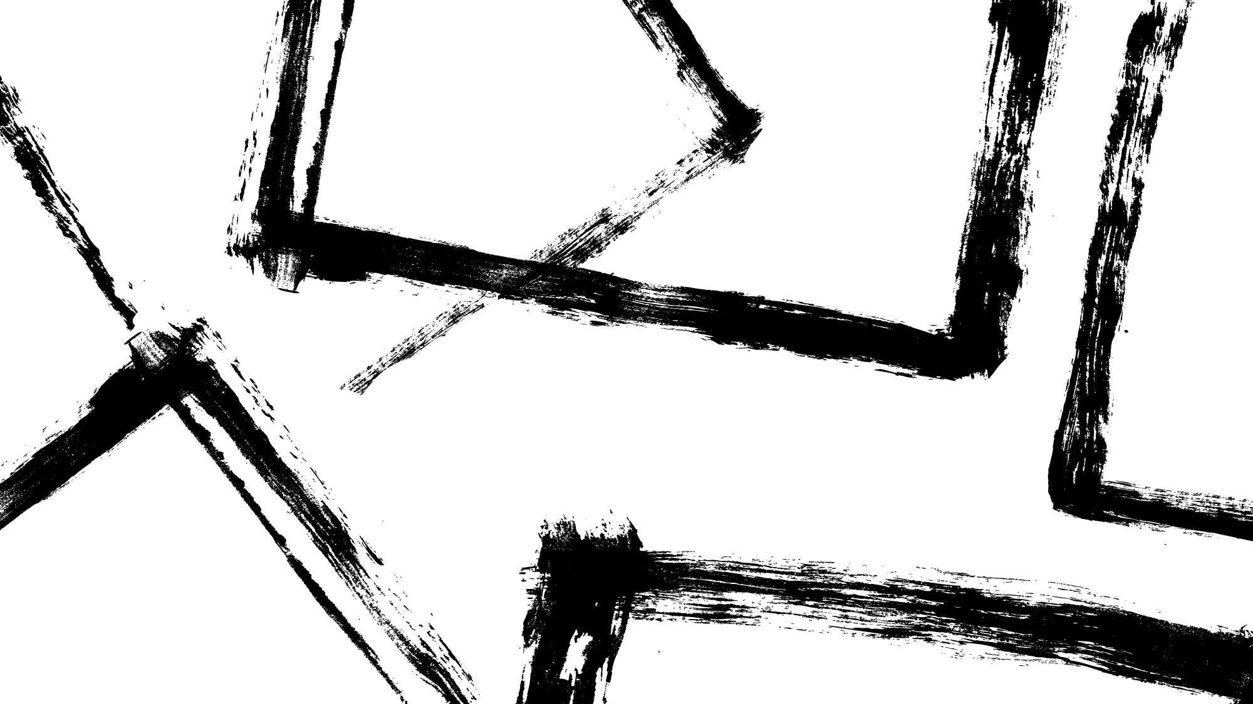
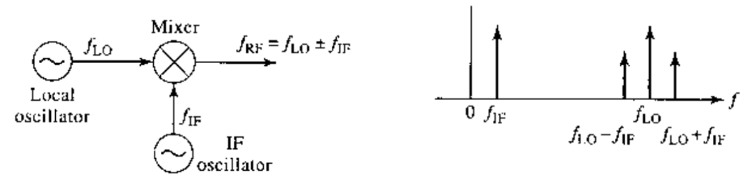
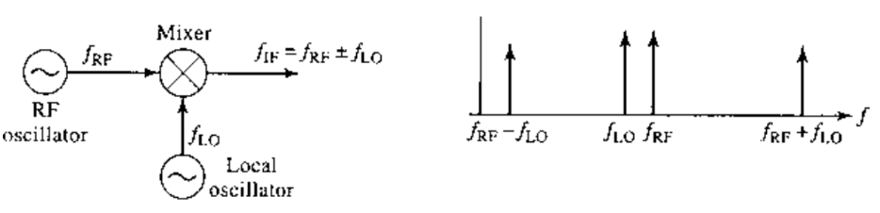
Frequency Up/Down Conversion

Slide 3
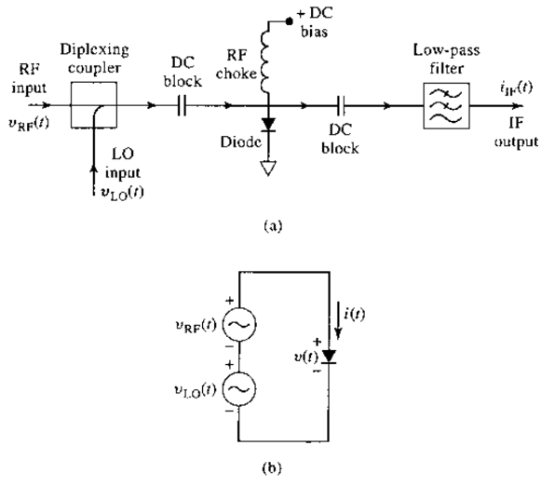
Single-Ended Diode Mixers

Slide 4
Antennas

Slide 5
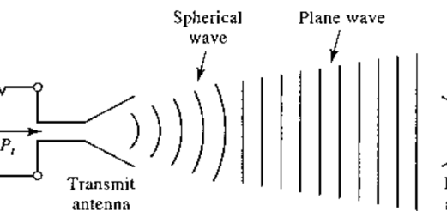
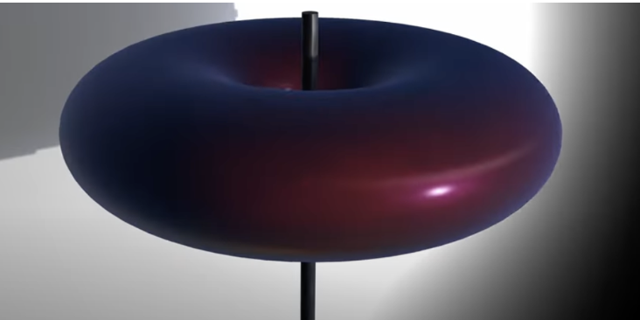
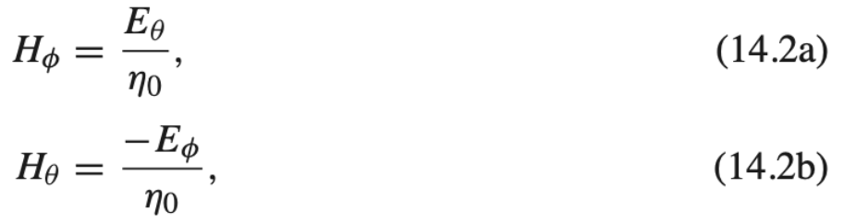
System Aspects of Antenna (I don’t get)

Slide 6
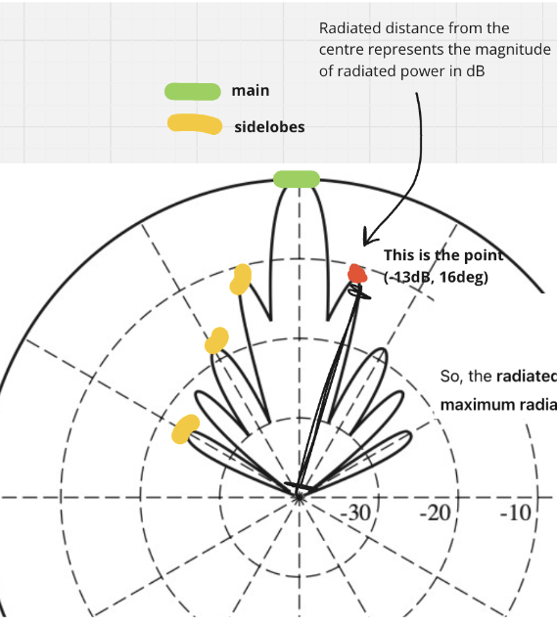
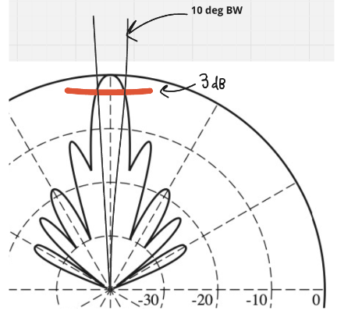
Antenna Pattern Characteristics

Slide 7
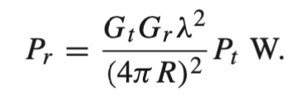
Wireless Communication
Used in broadcast radio and television, cellular telephone and networking systems, direct broadcast satellite (DBS) television service, wireless local area networks (WLANs), paging systems, Global Posistioning Systems (GPS) service, and radio frequency identifications (RFID) systems
Characterizing:
Pt-pt
pt-multipt
Multipt-multipt
Simplex, half/full duplex
FRIIS FORMULA:

Slide 8
Factors Affecting Signal Integrity
- Mismatch at either antenna
Polarization mismatch between antennas
Propagation affects leading to attenuation or depolarization
Multipath effects that cause partial cancellation of the received field
Line losses

